Slide 1
Java Basics 2

Slide 2
Methods
a method is a set of code used to write the logic of the applications which perform some specific tasks.
In Java programming, a method is executed when it is called from another method.
The main() method is the first method that is executed by JVM(Java virtual machine) in java program.
If we want to want to execute any other method, we should call it from the main() method.
When a method is called, it returns a value to the calling method. It can also perform a task without returning any value to the calling method.
A method can be called from anywhere in Java program.
The purpose of using methods in the Java program is to write the logic of the applications.

Slide 3
Method declaration in Java With ex
A method must be declared inside the class.
A method has 6 fundamental parts, Such as,
Access modifier
Return type
Method name
Parameter list
Exception list
Body
Syntax:
method_modifier return_type method_name(Parameter_list) throws exeptions
{ Method body}

Slide 4
1. The method modifier defines the access type of a method but it is optional to use. It may be declared as static, final ,abstract, synchronized, or one of the access specifiers private, default, protected, and public.
The public is the least restrictive access modifier and the private is the most.
2. If the method is abstract, the implementation is omitted and the method body is replaced with a single semicolon.
3. The return type defines the type of data that comes back from the method after calling it.

Slide 5
Method signature in Java
The method name with parameter list (number of parameters, type of parameters, and order of parameters ) is called method signature in java.
Example:
add(int a,int b)// Number of parameters is 2 and the type is int.
m1(String name) //Number of parameter is 1 and the type is string.
Sub() //No Parameter.
Parameter list: The parameter list is a comma-separated list of zero or more parameter declaration.

Slide 6
Points to Remember
1. The return type and exceptions are not part of the method signature.
2. The method name should be functionality name related to logic.
3. The exceptions may be thrown by the methods. In this case, you can specify the exceptions.
Here are some examples of different types of method declaration in java.
1. public void add(int a, int b); // Here, add is the functionality/method name. It will execute whenever we will pass input values of a and b.
Once the functionality is completed, void represents don’t return any value. The public is access modifiers which represent that this method can be accessed from anywhere.
2. private int m2(); // m2 is functionality/method name with no argument. Once the functionality is completed, it must return an integer value. The private access modifier represents that it can be accessed only within the class.
3. protected int sub(int a) throws Exception.

Slide 7
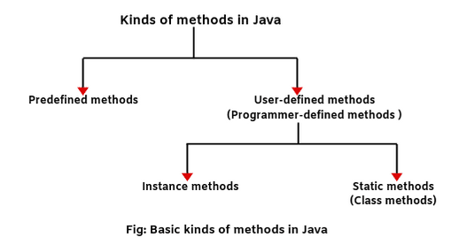
Types of Methods
1.Predefined
2.User defined

Slide 8
Predefined methods in Java are those methods that are already defined in the Java API (Application Programming Interface) to use in an application.ex:
1. print() is a predefined method present in the package java.io.PrintSteam. The print(“….”) prints the string inside the quotation marks.
2. sqrt() is a method of Math class which is present in package java.lang. It calculates the square root of a number. Let’ take an example program based on java predefined methods.
Let’s take an example program where we will use sqrt() method of Math class to find out the square root of number 16.

Slide 9
User defined Methods
User-defined methods in Java are those methods that are defined inside a class to perform a special task or function in an application. Such methods are called user-defined methods.
A user-defined method is also known as programmer-defined method. We can declare two types of user-defined methods in an application.
1. Instance Method or Local Method // Only accessed by Class object 2. Static Method // static void m2();
When you declare any method with a static modifier, it is called static method. A static method is linked with class.
Therefore, it is also known as a class method. It is used to implement the behavior of the class itself. Static methods load into the memory during class loading and before object creation.

Slide 10
Points to remember
An instance method can refer to static variables (class variables) as well as for instance variables of the class.
A static method can refer to only static variables.
3. If you call instance members (variables or methods) from instance area within an instance area (i.e, same area), you don’t need to use object reference variable for calling instance variables or methods. You call it directly.
4. If you call instance variables or methods from the instance area within the static area (i.e, different area), you cannot call directly them. You will have to use object reference variables for calling them.
5. If you call static members (variables or methods) from the static area or instance area, we don’t need to use the class name for calling the static members. You can invoke them directly.
6. When you want to call static members from outside the class, static members can be accessed by using the class name only.

Slide 11
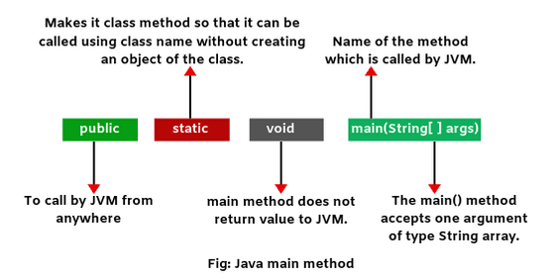
Java Main Method

Slide 12
1. public static void main(String args[ ]) is a line at which the program will start executing.
2. main() method in java is always called by JVM (Java Virtual Machine) before any objects are created.
3. It does not return any value.
4. Since Java is case-sensitive, Main is different from main. If you type Main instead of main, java compiler would still compile your program but java will report an error because it would not find main() method.
5. If a program does not contain the main method in a class, Java compiler will compile it but cannot run it.
6. Java main() method can be overloaded but cannot override it.

Slide 13
Aruguments
Arguments in Java are the actual values that are passed to variablesdefined in the method header when the method is called from another method.
That is, whenever any particular method is called during the execution of the program, there are some values that are passed to call that particular method. These values are called arguments.
The passed argument values replace those parameters which have been used during method definition and the body of method is then executed with these values.
The type of argument values passed must be matched with the type specified for the corresponding parameter in the definition of method. Sometimes, an argument is also called actual parameter.
int x=add(3,5);
int y=sum(2,4);

Slide 14
Parameter
In Java, a parameter is a variable name with type that is declared within the method signature. The list of parameters is enclosed in parenthesis.
Each parameter consists of two parts: type name, and variable name. A type name followed by a variable name defines the type of value that can be passed to a method when it is called. It is also often called formal parameter.
Parameters declared in the method signature are always local variables that receive values when the method is called from another method.
Ex:
public int add(int a,int b){
Return a+b;
}
The method add() has two parameters, named a and b with data type int. It adds the values passed in the parameters and returns the result.

Slide 15
Parameter type
We can use any data type such as primitive data types including int, float, double, char, short, byte, String, and object reference variables for a parameter of a method and constructor.
There is no standard limit to specify the number of parameters in the definition of a method. But you should limit the number of parameters almost 6 to 7. Any more will have a negative effect on the readability of your code.
Points to remember:
1. A parameter is a variable in the definition of a method whereas an argument is an actual value of this variable that is passed to the method’s parameter.
2. A parameter is also called formal parameter whereas an argument is also called actual parameter.

Slide 16
Continues…
1. Variables defines in the method header are called formal parameters or simply parameters.
2. Parameters in a method header are optional; that is, a method may or may not contain parameters.
3. If a method contains parameters, we need to pass values to parameters when a method is invoked. These values are called arguments or actual parameters.
4. A method header represents modifiers, return type value, method name, and parameters of the method.
5. The method name and parameter list together is called method signature.
6. Parameters defined in the method header are always local variables.

Slide 17
Call by value
Calling the method by passing the value is called Call by value.
Ex, f.add(2,3);

